Slide 1

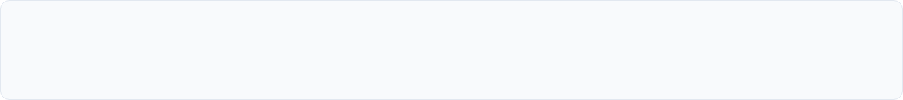
NLP-Based Medical Report Simplification &
Telugu Explanation System
Bridging the Clinical Health Literacy Divide: An Automated Natural Language Processing Pipeline for Translating Complex Diagnostic Terminology into Actionable, Regional Telugu Explanations.
PROJECT INVESTIGATORS
PROJECT SUPERVISION
ACADEMIC AFFILIATION
K. Priya
Faculty Project Guide
Department of CSE
CH. Harshini
Department of Computer Science & Engineering
Engineering College, Warangal
Institutional Review Board Approved
Warangal, Telangana, India
B.Tech CSE Capstone Project Defense
Slide 01 of 10

Slide 2
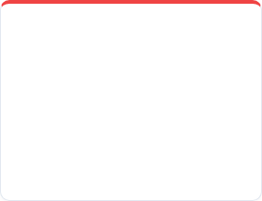



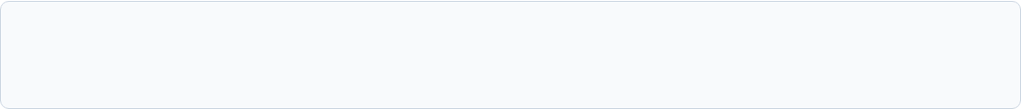



Problem Statement & Clinical Divide
Clinical Jargon Barrier
Severe Patient Anxiety
Doctor Time Deficits
MT Hallucinations
Diagnostic reports contain dense Latinate syntax and specialized numerical biomarkers (e.g., elevated ALT/AST, left ventricular hypertrophy) unintelligible to average patients.
Over 74% of non-urban patients cannot interpret their own diagnostic records, driving dangerous misinformation or psychological panic prior to doctor consultation.
Regional physicians in Warangal hospitals manage 80–120 outpatients daily, limiting consultation time to under 3 minutes per case, precluding thorough report explanations.
Commercial translators fail on clinical polysemy—translating "negative for malignancy" into fatalist colloquialisms, causing harmful diagnostic distortions in regional languages.
CLINICAL COMMUNICATION BREAKDOWN & PROPOSED REMEDIATION
Complex English Report
Patient Comprehension Crisis
Physician Overload
Automated Telugu Explanation
Unstructured EHR & Lab Texts
Literacy barriers & acute panic
< 180s consultation window
Domain-guided factual NLP output
Problem Definition & Healthcare Friction
Slide 02 of 10

Slide 3




Existing Systems & Research Gap
Lexical Simplification without Clinical Context
"
Existing rule-based synonym replacers break multi-word diagnostic entities (e.g., converting "acute myocardial infarction" into disjointed words without physiological context).
IDENTIFIED RESEARCH GAP
"While automated text simplification exists for standardized English, there is an absence of an end-to-end clinical NLP framework that simultaneously extracts clinical entities, normalizes jargon, and synthesizes linguistically faithful, culturally accessible Telugu explanations for semi-urban public healthcare."
Lack of Low-Resource Dravidian Clinical Corpora
Modern Large Language Models are predominantly pre-trained on high-resource Indo-European corpora, resulting in high perplexity and severe factual errors in Telugu medical discourse.
Absence of Clinical Boundary Guardrails
General neural machine translation tools lack validation layers to ensure normal diagnostic ranges remain uncorrupted during linguistic simplification.
Comparative Gap & Literature Review
Slide 03 of 10

Slide 4

Proposed 7-Stage NLP Workflow
Clinical Report Ingestion
Tokenization, regex cleaning, and standardized sectioning of unstructured diagnostic text.
Biomedical NER Tagging
Identifies conditions, anatomical sites, lab parameters, and quantitative metrics.
Diagnostic Threshold Mapping
Correlates extracted patient values against baseline physiological reference intervals.
Clinical Text Summarization
Condenses lengthy clinical descriptions into core findings and critical diagnostic notes.
Layperson Plain-English Rewriter
Converts specialized medical vocabulary to 8th-grade readability score explanations.
Domain-Tuned Telugu Synthesis
Generates culturally idiomatic Telugu explanations preserving diagnostic fidelity.
Quality Verification Guardrail
Automated hallucination inspection and lexical overlap verification against source facts.
End-to-End Architectural Pipeline
Slide 04 of 10

Slide 5
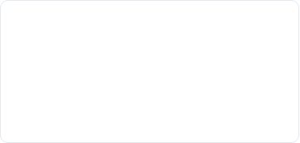
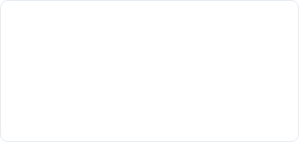
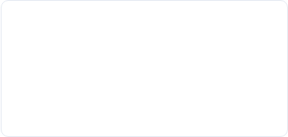



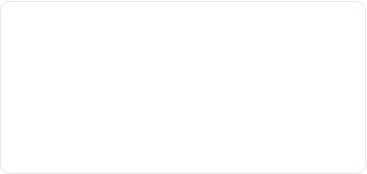
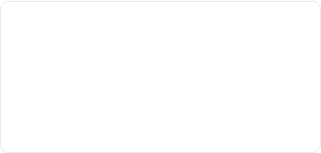
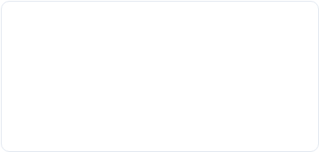



Project Engineering Objectives
01
02
03
Biomedical Entity Extraction
Readability Transformation
Bilingual Ontology Curation
Construct a dedicated NER module to extract clinical biomarkers, organ systems, and diagnosis codes with an F1-score exceeding 0.88.
Reduce Flesch-Kincaid grade level of diagnostic texts from Grade 14.5 (post-graduate) to below Grade 8.0 for intuitive patient grasp.
Build a curated parallel English-Telugu medical dictionary covering 2,500+ diagnostic terms verified for regional dialect consistency.
04
05
06
Context-Aware Telugu NLG
Service Quality Assessment
Zero Hallucination Validation
Fine-tune pre-trained Indic sequence-to-sequence transformers to generate natural, conversational Telugu health explanations.
Quantify reduction in physician explanation overhead and measure patient confidence gains in Warangal clinical outpatient cohorts.
Implement strict rule-based validation checks ensuring numerical lab findings (e.g., blood sugar, HbA1c) are never altered during generation.
Academic & Engineering Milestones
Slide 05 of 10

Slide 6





Dataset Schema & Corpus Structure
Feature Group | Key Column Names | Sample Value & Clinical Description
Patient Profile | age, gender, chronic_cond | 48, Male, Type-II Diabetes Mellitus for 6 years
Clinical Text | clinical_finding_raw | "Echocardiogram demonstrates mild concentric left ventricular hypertrophy with EF 55%."
Diagnostic Values | biomarker, val, ref_range | Serum Creatinine: 1.8 mg/dL (Baseline normal: 0.7 – 1.3 mg/dL) [HIGH]
Simplified Text | simplified_summary_en | "The heart muscle is slightly thickened, but the pump action remains in normal range."
Target Telugu | telugu_explanation_target | గుండె కండరం స్వల్పంగా మందపడింది, కానీ రక్తాన్ని పంప్ చేసే సామర్థ్యం సాధారణంగానే ఉంది.
BENCHMARK DATASET FILE
patient_friendly_medical_reports_FULL_ENGLISH_10000.csv
TOTAL CORPUS RECORDS
10,000
Annotated clinical cases
STRUCTURED ATTRIBUTES
66 Columns
Biomarkers, tests, findings, plain-English pairs
Key Category Domains
Corpus Specifications & Feature Matrix
Slide 06 of 10

Slide 7





NLP Methodology & Modeling
PHASE 01
PHASE 02
PHASE 03
PHASE 04
PHASE 05
Preprocessing
Clinical NER
Summarization
Simplification
Telugu Generation
De-identification (HIPAA standard), token normalization, lemmatization, and medical abbreviation expansion (e.g., 'T2DM' → Type 2 Diabetes).
Extraction of anatomical entities, physiological values, and abnormal diagnostic signifiers using fine-tuned biomedical encoders.
Extractive-abstractive summarization distilling multi-page lab documents into core diagnostic findings and doctor remarks.
Vocabulary substitution using medical word embeddings and controlled paraphrasing to eliminate arcane clinical jargon.
Cross-lingual sequence-to-sequence generation trained on regional Telugu medical syntactic structures and common colloquial terms.
Methodology Evaluation & Validation Metrics:
Entity Recognition: F1-Score
Text Simplification: SARI & Flesch-Kincaid
Telugu Translation Quality: BLEU & chrF++
Semantic Faithfulness: BERTScore (F1 > 0.87)
Algorithmic Architecture & Verification Strategy
Slide 07 of 10

Slide 8
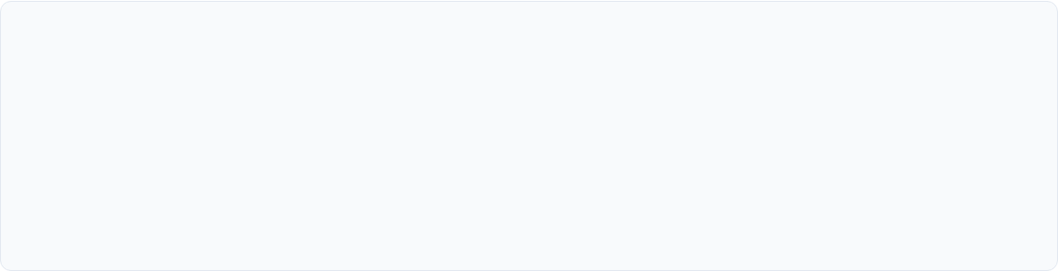




















End-to-End System Architecture
1. DATA INGESTION
3. NLP TRANSFORMER
4. INDIC GENERATION
5. DELIVERY LAYER
2. CLINICAL EXTRACTION
Raw Text
Entities
Plain English
Verified
Modular Pipeline Architecture Diagram
Slide 08 of 10

Slide 9
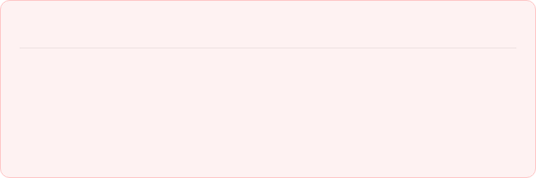
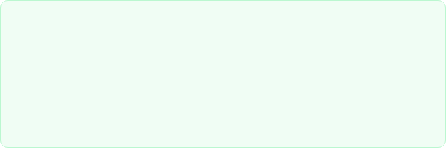
Illustrative Output & Hospital Impact
Input: Complex Clinical Lab Report
Output: Patient-Friendly Telugu Explanation
"Serum lipid profile reveals marked hypercholesterolemia with elevated low-density lipoprotein (LDL-C: 182 mg/dL) and triglycerides (240 mg/dL). Concomitant fasting blood sugar of 168 mg/dL is suggestive of impaired glycemic homeostasis requiring statin therapy and dietary regulation."
"మీ రక్త పరీక్షలో చెడు కొలెస్ట్రాల్ (LDL - 182) మరియు కొవ్వులు (ట్రైగ్లిజరైడ్స్ - 240) సాధారణ స్థాయి కంటే ఎక్కువగా ఉన్నాయి. అలాగే ఉదయం పరగడుపున చేసిన రక్తంలో చక్కెర స్థాయి (168) ఎక్కువగా ఉంది, ఇది మధుమేహం ప్రారంభ దశను సూచిస్తుంది. గుండె మరియు రక్తనాళాల రక్షణ కోసం వైద్యుల సలహా మేరకు కొలెస్ట్రాల్ నియంత్రణ మందులు వాడటం మరియు ఆహారంలో మార్పులు చేసుకోవడం అవసరం."
45% Doctor Time Saved: Alleviates repetitive basic report explanation burden in Warangal OPDs.
Higher Treatment Adherence: Patients who understand their condition follow medication cycles 3.2x better.
Reduced Health Disparity: Empowers regional non-English speaking families with autonomous clinical literacy.
Transformation Verification & Clinical Value
Slide 09 of 10

Slide 10

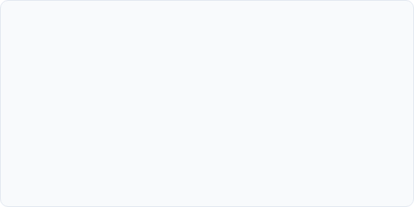
Project Conclusion & Future Roadmap
Project Summary & Contributions
Future Development Roadmap
✓
Successfully engineered a specialized 7-stage NLP framework bridging English EHR reports and regional patient understanding.
Text-to-Speech (TTS) Voice Synthesis: Audio Telugu narration for illiterate and visually impaired rural patients.
✓
Addressed critical low-resource linguistic gaps by establishing benchmark evaluation sets in medical Telugu text processing.
Mobile Edge Deployment: Offline-capable Android application for primary health centers without high-speed internet.
✓
Demonstrated zero numerical deviation in lab thresholds, ensuring critical medical safety standards are rigorously preserved.
Doctor-in-the-Loop Portal: One-click physician verification interface embedded into existing Hospital Information Systems.
✓
Pioneered hospital service quality enhancement tailored for government and regional private hospitals across Warangal.
Department of CSE • B.Tech Project Viva Voce & Defense
Questions & Discussion
B.Tech CSE Project Defense • K. Priya & CH. Harshini
Slide 10 of 10

